Slide 1
WEIGHTRON
OPTIMIZING COAL LOADING FOR EFFICIENT RAIL TRANSPORT: ADDRESSING OVERLOADING AND UNDERLOADING CHALLENGES
SRI SAIRAM ENGINEERING COLLEGE,
SAI LEO NAGAR WEST TAMBARAM
CHENNAI - 44
SRICHARAN K III/ICE
KEERTHIKA G III/ECE
SRINIVASAN N III/AI&DS
RESHMI T III/EEE

Slide 2
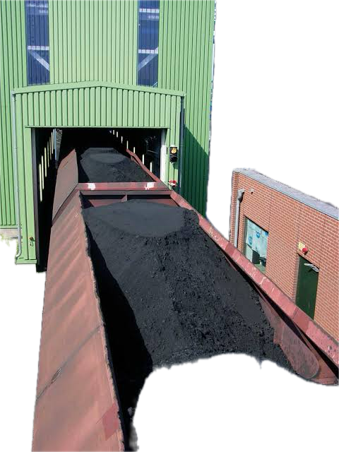
PROBLEM STATEMENT
A System of IOT devices to prevent Underloading /Overloading of railway wagons
CIL has experienced significant financial losses due to difficulties in wagon loading, including fines for overloading and additional expenses from under loading, which exceeded the actual contract value of Rs. 593 Crores in 2021-2022.

Slide 3
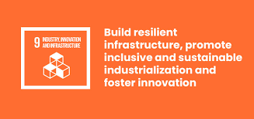


Sustainable development goals
PRIMARY
SECONDARY
TERTIARY

Slide 4
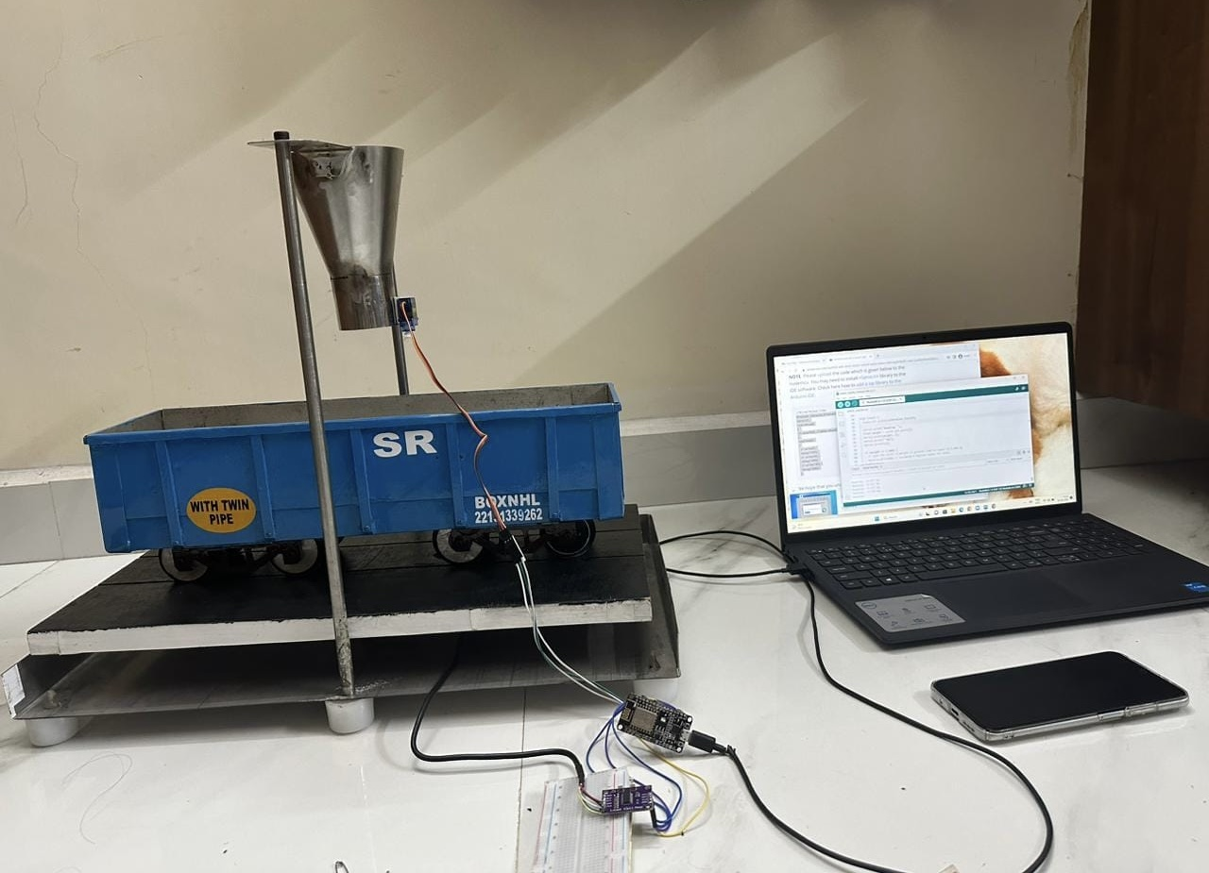
PROBELM SOLUTION
PROTOTYPE
Installing load cell, under the surface of the track to continuously measure the weight of the wagon
●Equipping wagon with IoT communication modules to transmit weight data in real-time to a centralized control system, ensuring immediate monitoring and signal is passed to servo motor once the maximum weight is reached
●Integrating an alerting mechanism within the central control system to detect under-loading or overloading. When such conditions are identified, immediate alerts are generated and transmitted to Coal India Limited.

Slide 5
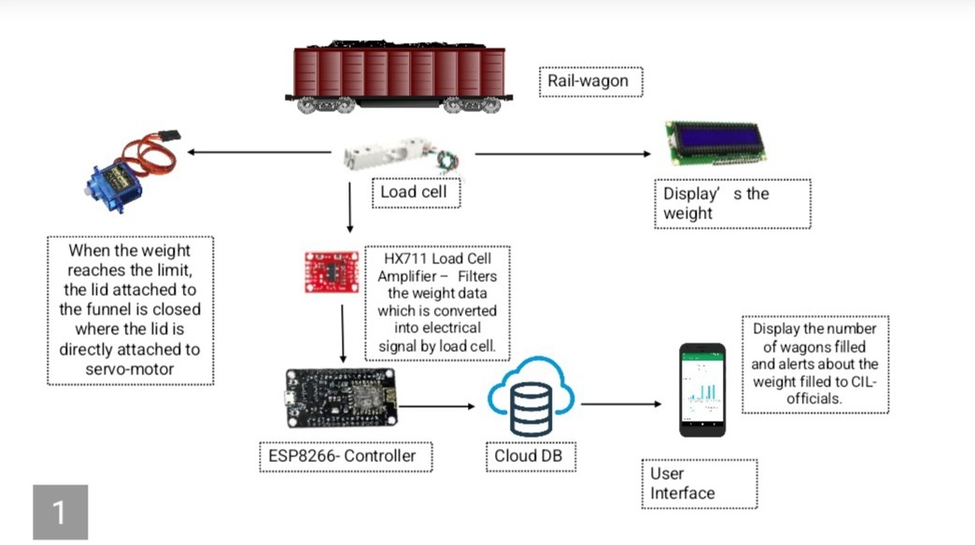
ARCHITECTURAL DIAGRAM

Slide 6
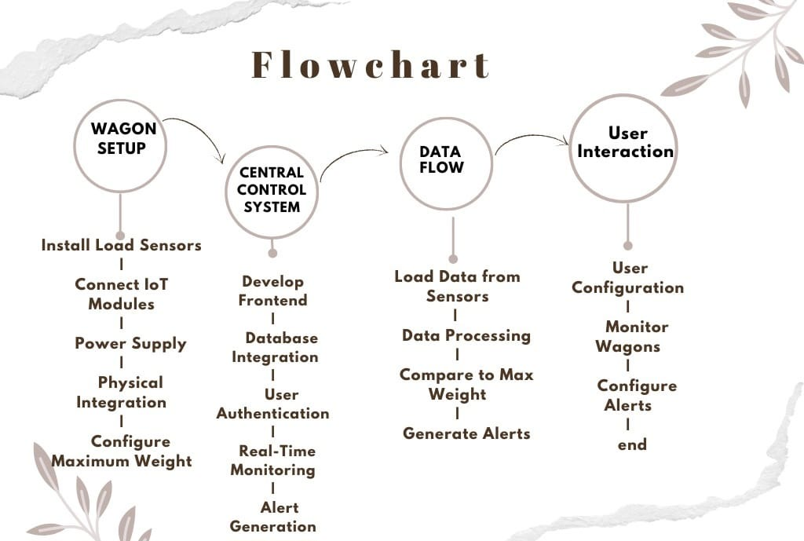

Slide 7
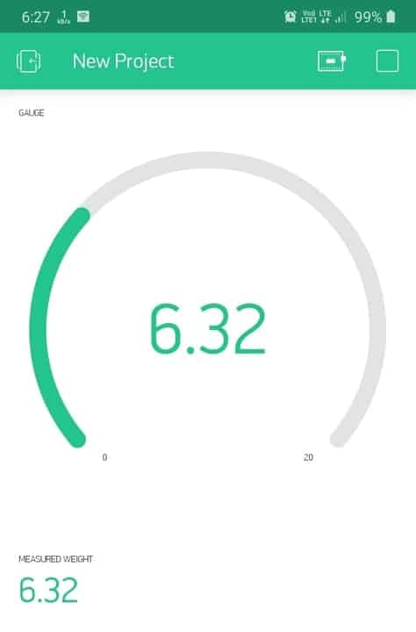
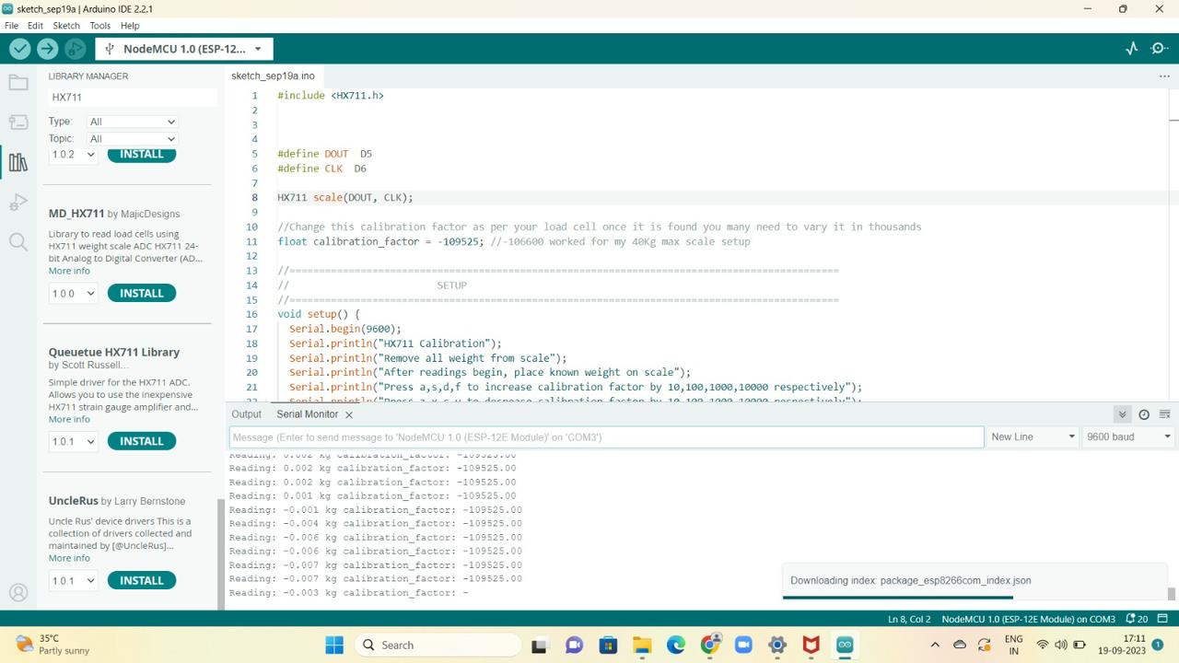
PROTO TYPE OUTPUT
BLYNK APP OUTPUT
CALIBRATION OUTPUT

Slide 8
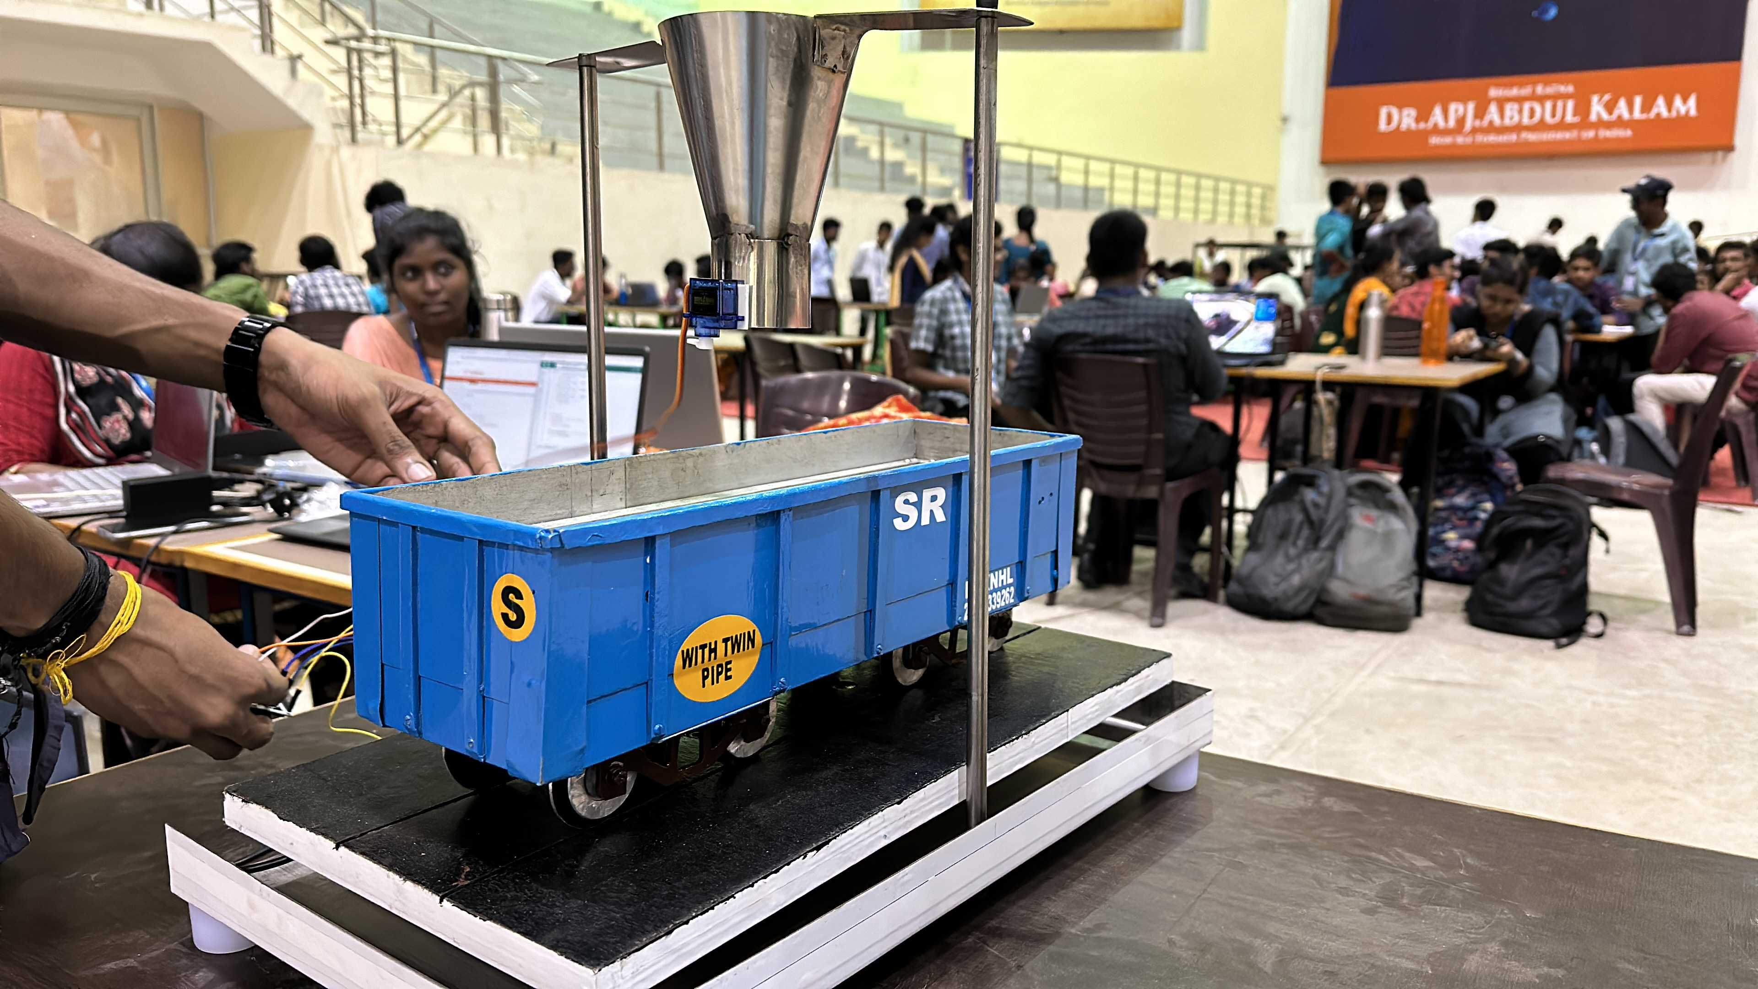
PROTO TYPE MODEL

Slide 9
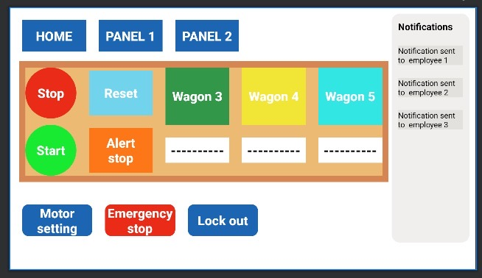
CONTROL PANEL
An IOT based control panel is designed in order to generate the alert signals
The main function of this control panels is to indicate live operation that is being functioning at the coal filling section
We have also enabled an option that maintains the records of wagons
In case of any emergency the alert will be sent through the SMS E-MAIL to the registered employee ID I.e those who work in the filling or loading section of wagon

Slide 10
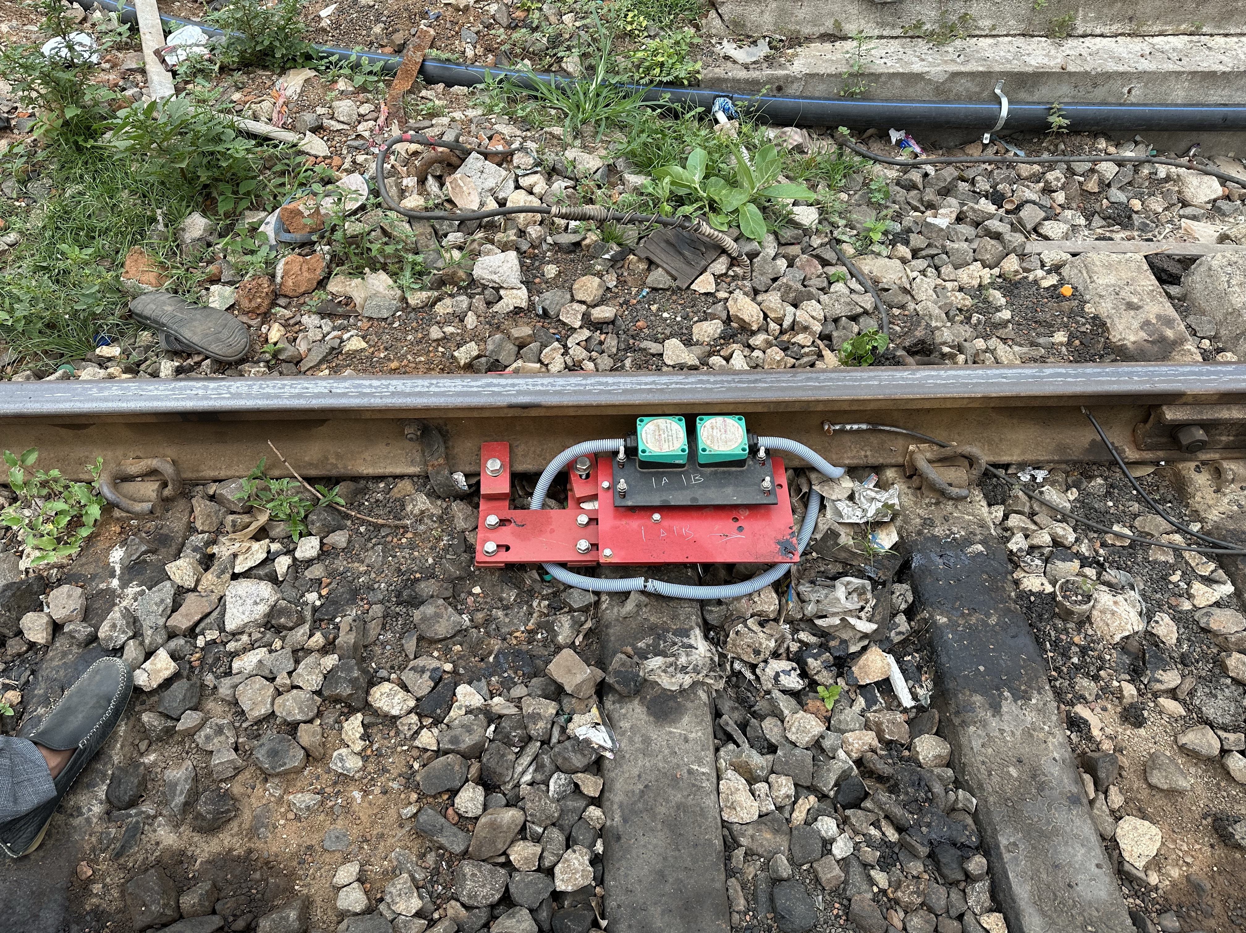
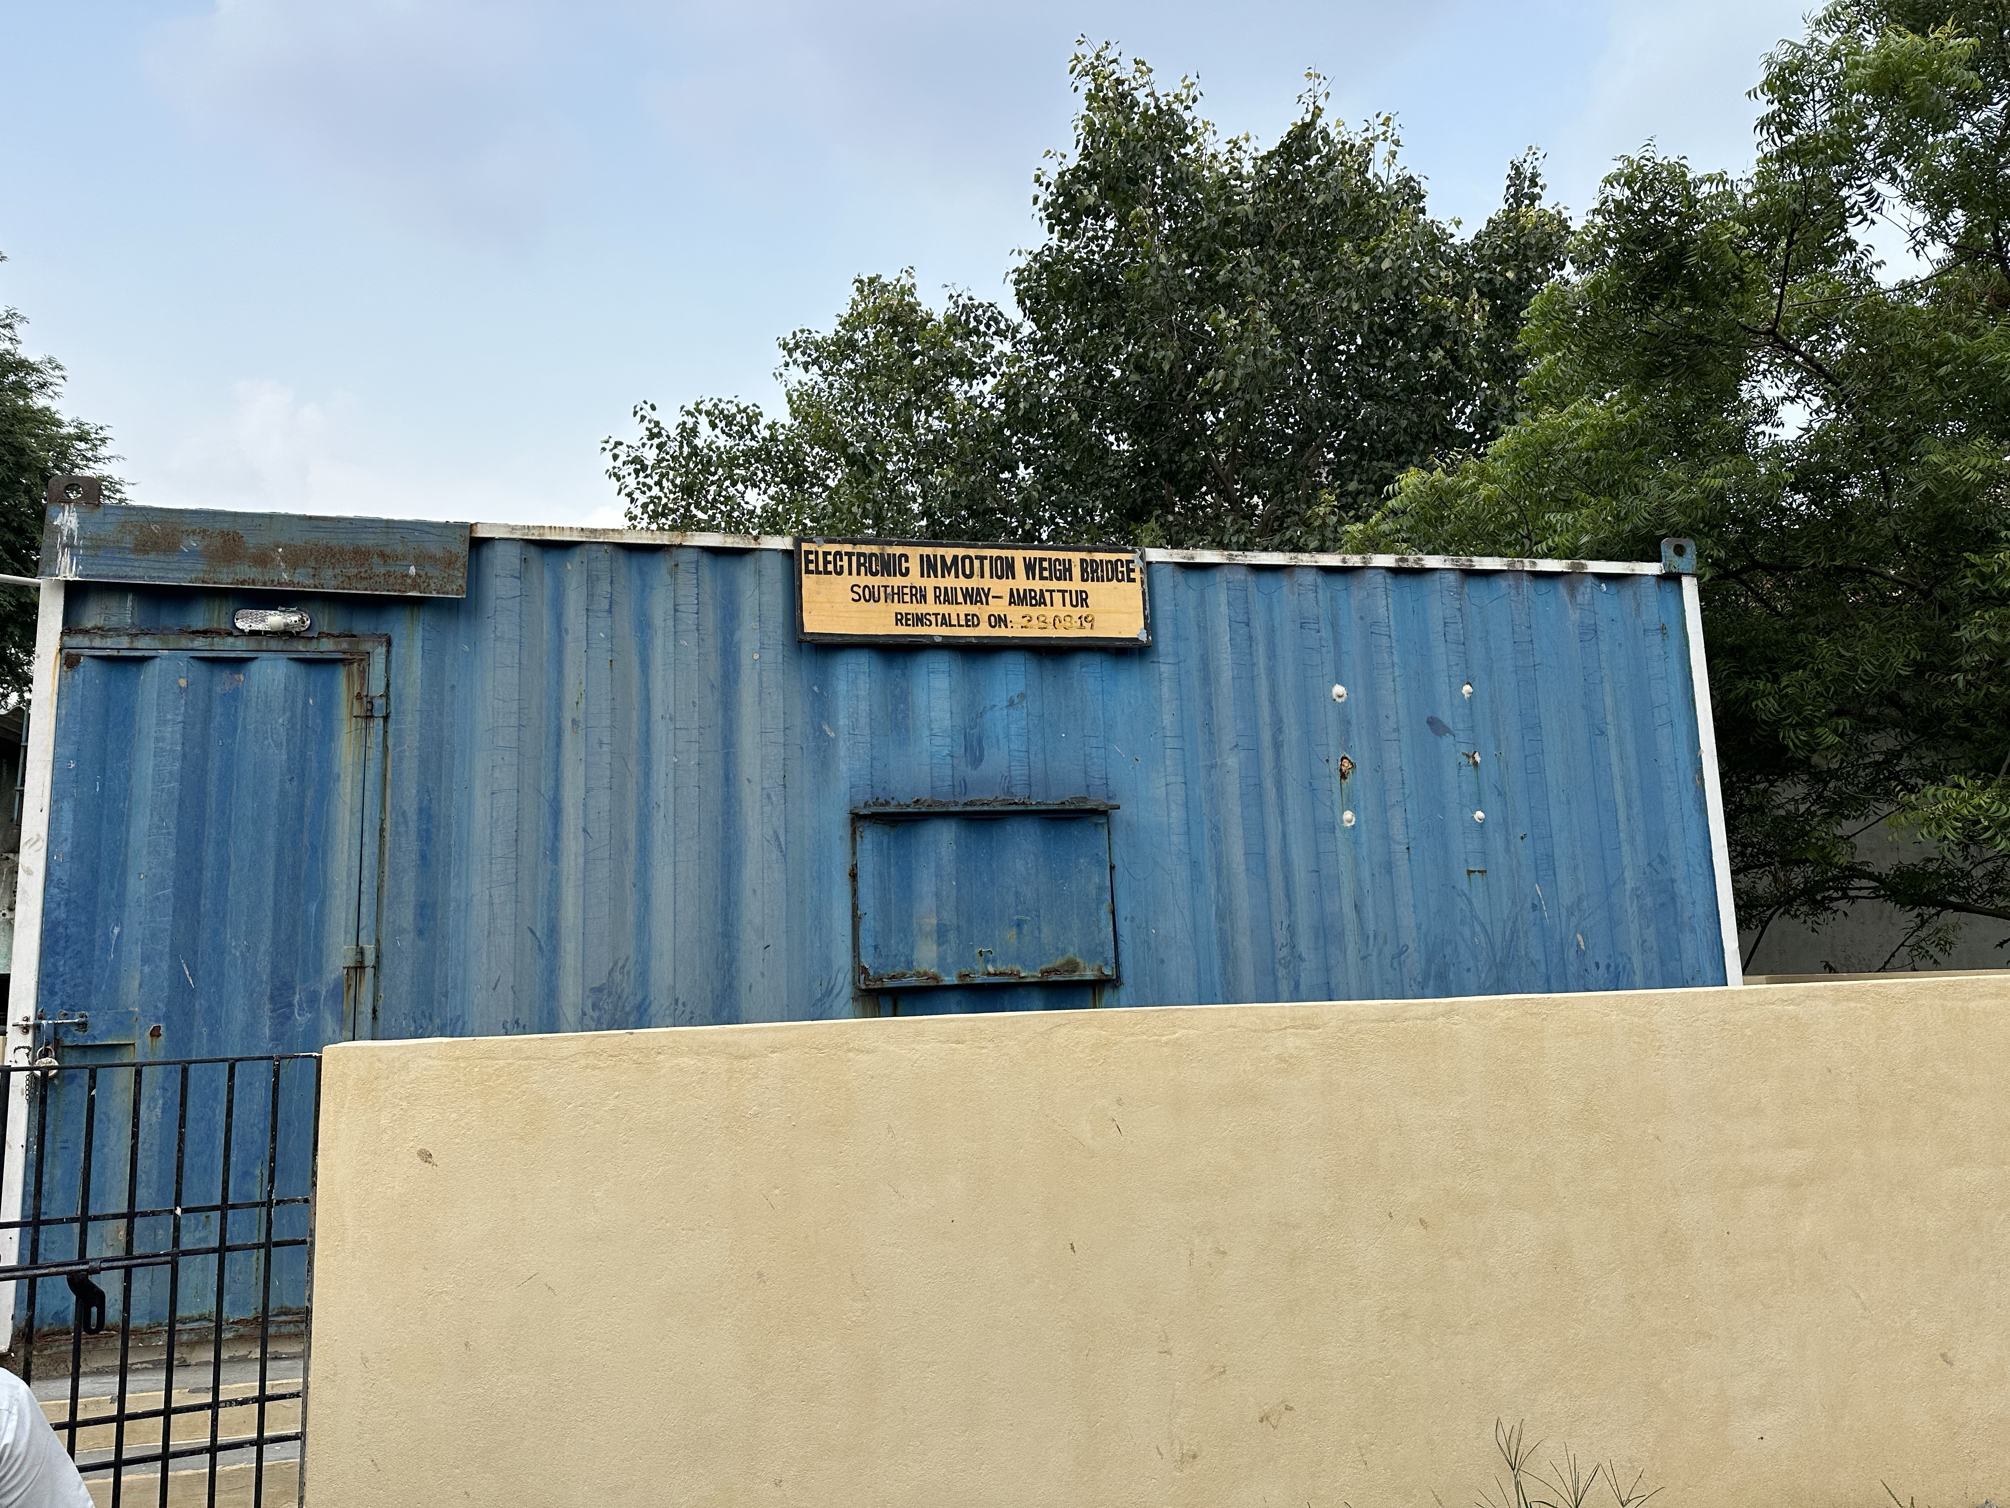
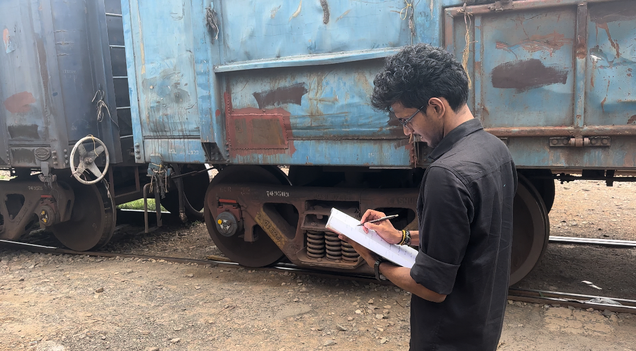
VISITED THE WEIGHT BRIDGE AT AMBATTUR CHENNAI TAMIL NADU

Slide 11
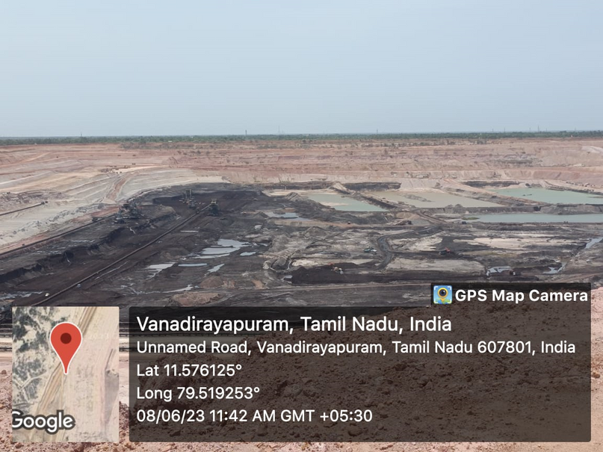
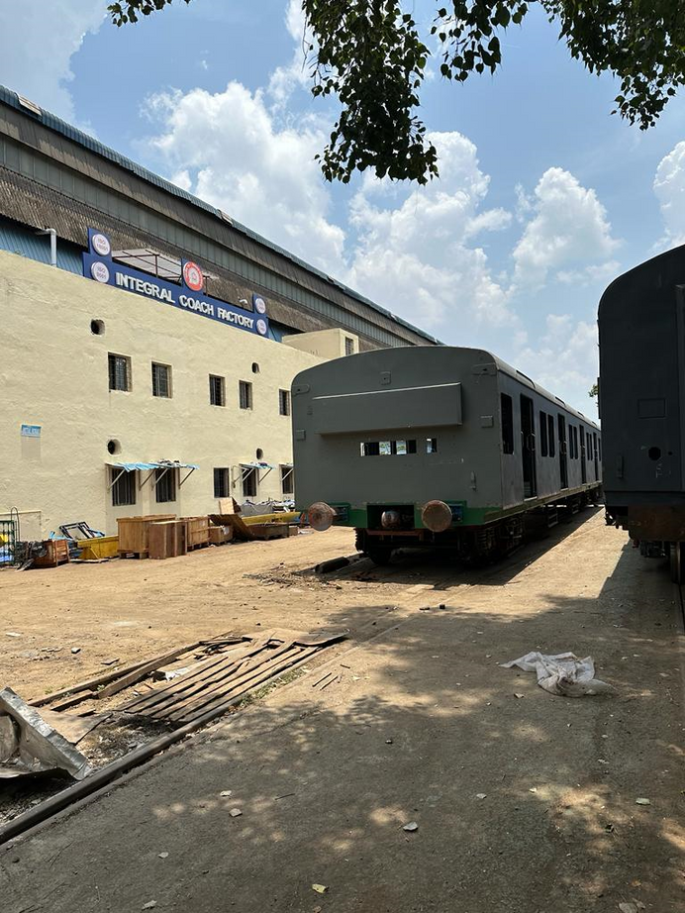
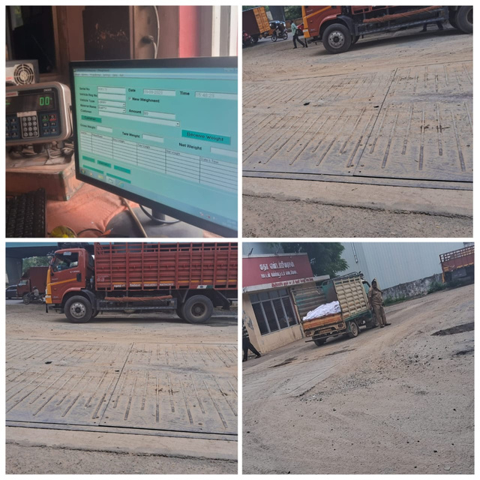



DOCUMENTATION AND INDUSTRIAL REFERENCES
1.INTERN AT NEYVELI LIGNITE CORPORATION INDIA LTD
2.INTERN AT INTEGRAL COACH FATORY
3.VISIT TO TRUCK BAY
ICF: PARTHASARATHY, Shop 30 general SSC,
N. GAJARAJ B Shop Shell Division Integral Coach Factory
INFOSYS : K.BALA KRISHNA principal consultant in ECSADM
NLC: Bala C M TS 2,Kapaldurai G Chief Manager Mine 1A

Slide 12
Thank you

